Slide 1
CS5112: Algorithms and Data Structures for Applications
Reductions, lower bounds, hashing
Ramin Zabih
Some content from: Wikipedia;
J. Leskovec, A. Rajaraman, J. Ullman: Mining of Massive Datasets, http://www.mmds.org

Slide 2
Administrivia
Class average on the duck problem (reductions) was by far the lowest on the prelim
This is core CS material
Dynamic programming, NP completeness, hashing
The other hard problem (MST) was not core
A duck problem will be on the final exam
Today we’re going to go over this again
Bring your questions!

Slide 3
Lecture outline
Reductions to prove hardness
Lower bounds
Example problems
Universal and perfect hashing
String search with hashing
Distributed hash tables

Slide 4
Reduction key ideas
Turning one problem into another is incredibly powerful
Often to make a problem easy
PageRank, intelligent scissors, etc.
Most of the ‘greatest hits’ in CS
Sometimes to show a problem is hard
NP-hardness or lower bounds
Utility is not quite as obvious but it’s still important

Slide 5
Traveling Salesman Problem
Given a list of cities and the distances between each pair of cities, what is the shortest possible route that visits each city and returns to the origin city?
The decision version is whether there exists a route whose total distance is no greater than L.
Seems awfully similar to Hamiltonian cycle
They’re both graph problems
They’re both looking for cycles
Biggest difference seems to be the edge weights
Idea: we know Hamiltonian cycle is NP-complete. If we can reduce Hamiltonian cycle to Traveling Salesman Problem, we’ll know TSP is NP-complete as well.
Intuitively: we know Hamiltonian cycle is hard. If it’s easy to take the solution to TSP and determine a solution for Hamiltonian, that must mean TSP is hard too.

Slide 6
Example reduction
Suppose we can efficiently solve the duck problem by using the rabbit problem as our key subroutine
What follows from this?
What if we knew that the duck problem was NP hard?
What if we knew that the duck problem could not be solved in polynomial time?
Notes:
Informally: if the rabbit problem were easy (tractable), so is the duck problem
More precisely, rabbit in P implies duck in P
BUT NOT THE OTHER WAY AROUND
Duck NP-hard => R NP-hard
Duck not in P => R not in P
[What we actually know is that R is at least as hard as D]

Slide 7
Going in the other direction
Suppose we knew that there was a polynomial time duck problem algorithm.
We cam do this if we had a polynomial time rabbit algorithm
What does this tell us about the rabbit problem?
Can you write a sorting algorithm that calls SAT? Or TSP?
Notes:
Answer: tells us nothing
If you can solve D efficiently using R that only tells you that D hard => R hard
D easy does not imply R easy

Slide 8
Example problems (reductions)
Assume rabbit is in P. Show duck is in P.
Assume rabbit is NP-hard. Show duck is NP-hard.
Assume rabbit is NP-complete. Show duck is NP-complete.
Notes:
Show that you can solve D by calling R polynomially many times
Show that you can solve R efficiently by solving D
As above, but also show that you can very a solution to D in polynomial time

Slide 9
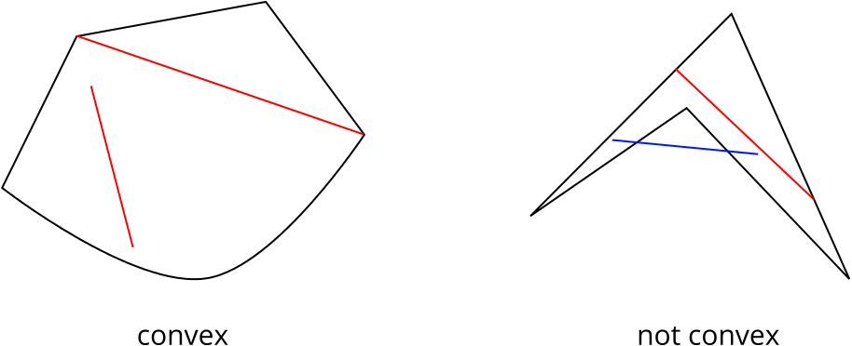
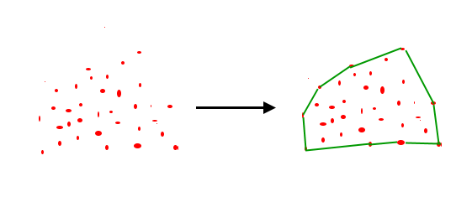
Convex hull problem
Figure source
Figure source

Slide 10
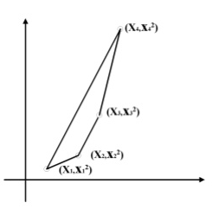
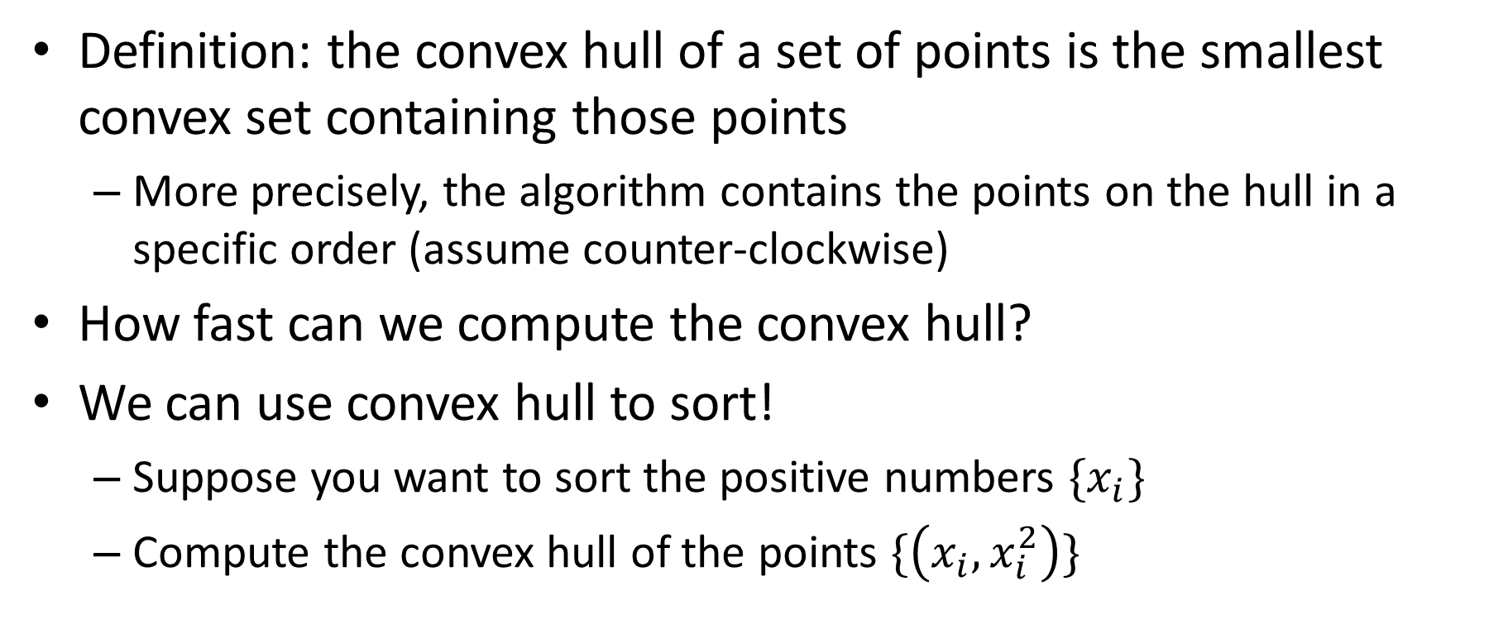
Convex hull lower bound
Definition: the convex hull of a set of points is the smallest convex set containing those points
More precisely, the algorithm contains the points on the hull in a specific order (assume counter-clockwise)
How fast can we compute the convex hull?
We can use convex hull to sort!
Suppose you want to sort the positive numbers $\{x_{i}\}$
Compute the convex hull of the points $\{\left(x_{i}, x_{i}^{2}\right)\}$
Figure source

Slide 11
Example problems (lower bounds)
In the following, what do we know about the duck problem’s lower bound, if anything?
Duck1 can efficiently solve sorting.
Sorting can be used to solve duck2.
Duck3 is solvable in polynomial time.
Duck4 is solvable in exponential time.
Duck5 is NP-hard.
Notes:
O(n log n) lower bound
Nothing
Nothing
Nothing
Nothing, really

Slide 12
Universal and perfect hashing
Back to hashing
We talked about perfect hashing (no collisions)
Minimal: table is exactly full
Main application is with fixed input data
Example: compilers
How do we generate perfect hash functions for our data?
Give up on minimality

Slide 13
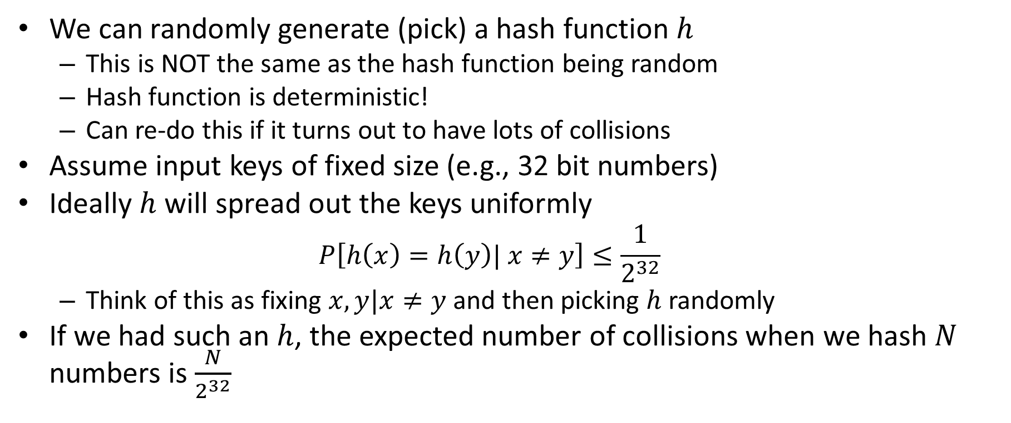
Universal hashing
We can randomly generate (pick) a hash function $h$
This is NOT the same as the hash function being random
Hash function is deterministic!
Can re-do this if it turns out to have lots of collisions
Assume input keys of fixed size (e.g., 32 bit numbers)
Ideally $h$ will spread out the keys uniformly
$$P\left[h\left(x\right)=h\left(y\right)| x≠y\right]≤\frac{1}{2^{32}}$$
Think of this as fixing $x,y|x≠y$and then picking $h$randomly
If we had such an $h$, the expected number of collisions when we hash $N$ numbers is $\frac{N}{2^{32}}$

Slide 14
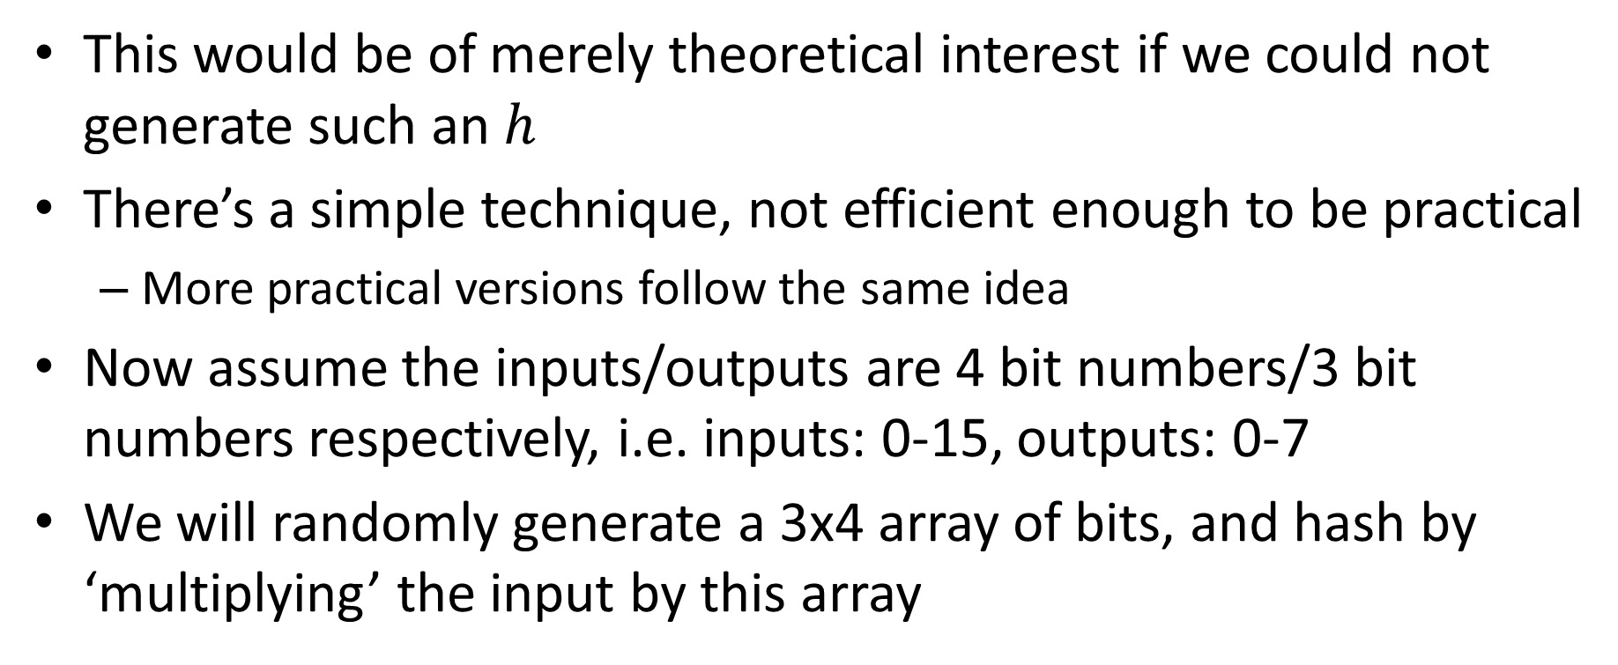
Universal hashing by matrix multiplication
This would be of merely theoretical interest if we could not generate such an $h$
There’s a simple technique, not efficient enough to be practical
More practical versions follow the same idea
Now assume the inputs/outputs are 4 bit numbers/3 bit numbers respectively, i.e. inputs: 0-15, outputs: 0-7
We will randomly generate a 3x4 array of bits, and hash by ‘multiplying’ the input by this array

Slide 15
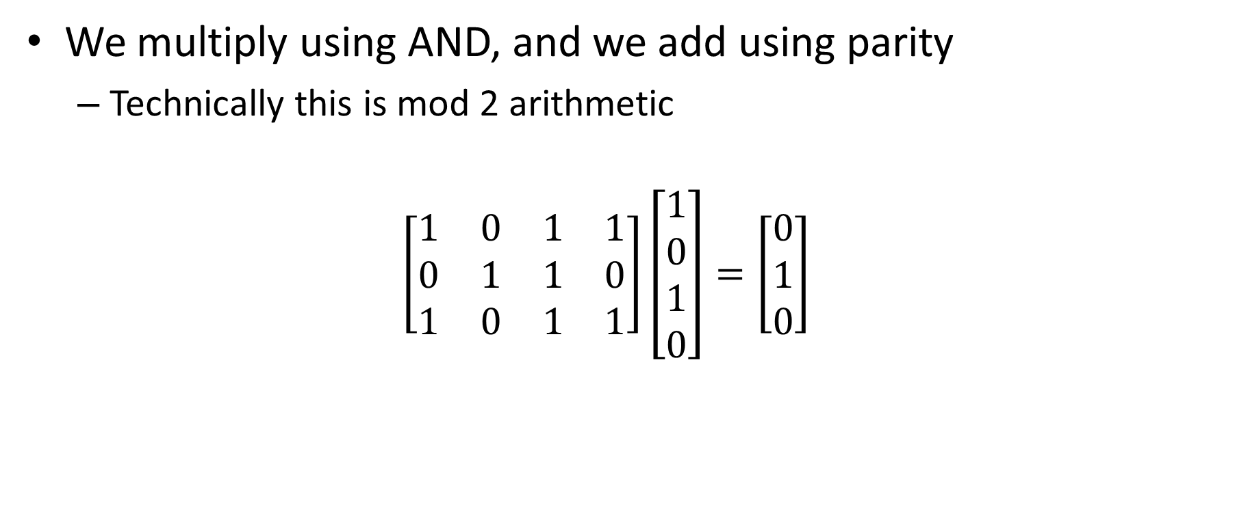
Universal hashing example
We multiply using AND, and we add using parity
Technically this is mod 2 arithmetic
$$\left[\begin{matrix}1 & 0 & 1 & 1 \\ 0 & 1 & 1 & 0 \\ 1 & 0 & 1 & 1\end{matrix}\right]\left[\begin{matrix}1 \\ 0 \\ 1 \\ 0\end{matrix}\right]=\left[\begin{matrix}0 \\ 1 \\ 0\end{matrix}\right]$$

Slide 16
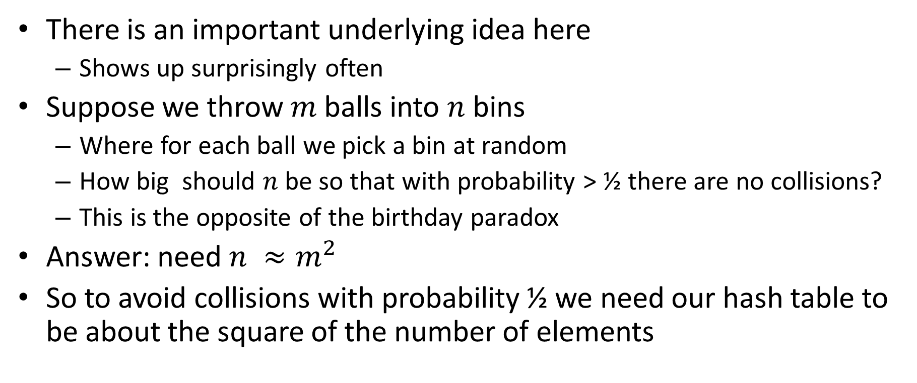
Balls into bins
There is an important underlying idea here
Shows up surprisingly often
Suppose we throw $m$balls into $n$ bins
Where for each ball we pick a bin at random
How big should $n$be so that with probability > ½ there are no collisions?
This is the opposite of the birthday paradox
Answer: need $n ≈m^{2}$
So to avoid collisions with probability ½ we need our hash table to be about the square of the number of elements

Slide 17
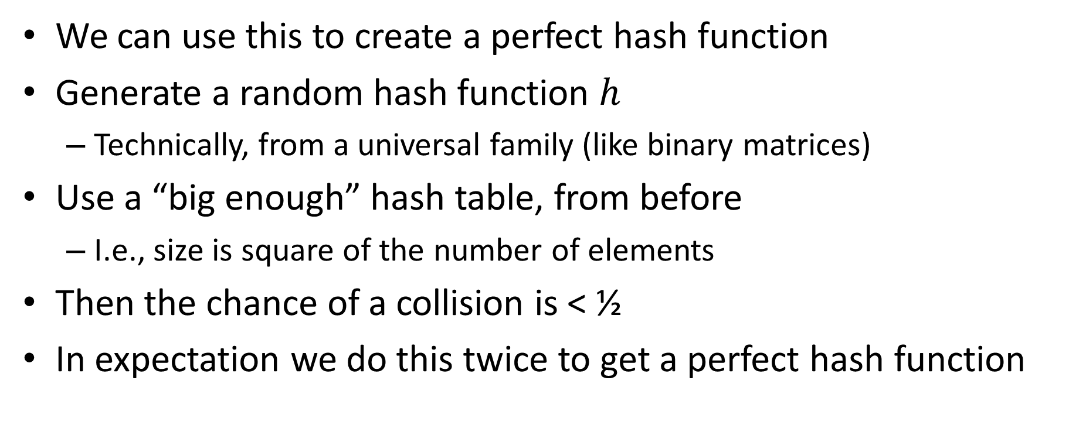
Perfect hashing from universal hashing
We can use this to create a perfect hash function
Generate a random hash function $h$
Technically, from a universal family (like binary matrices)
Use a “big enough” hash table, from before
I.e., size is square of the number of elements
Then the chance of a collision is < ½
In expectation we do this twice to get a perfect hash function

Slide 18
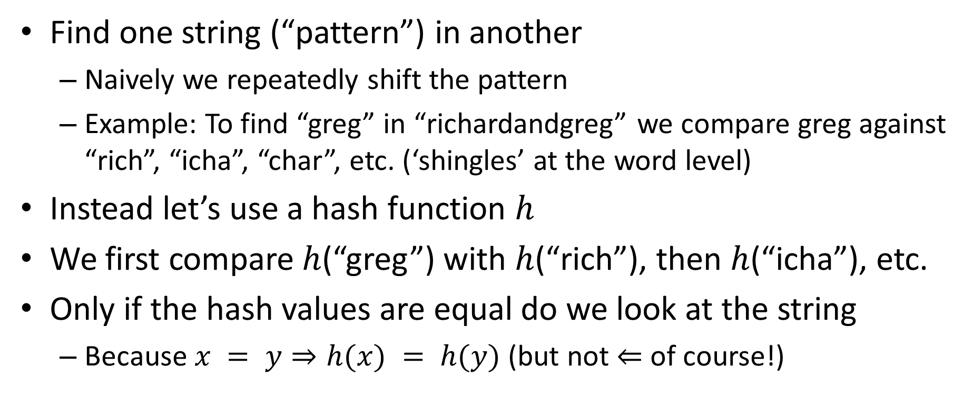
Rabin-Karp string search
Find one string (“pattern”) in another
Naively we repeatedly shift the pattern
Example: To find “greg” in “richardandgreg” we compare greg against “rich”, “icha”, “char”, etc. (‘shingles’ at the word level)
Instead let’s use a hash function $h$
We first compare $h$(“greg”) with $h$(“rich”), then $h$(“icha”), etc.
Only if the hash values are equal do we look at the string
Because $x = y⇒h(x) = h(y)$ (but not $⇐$ of course!)

Slide 19
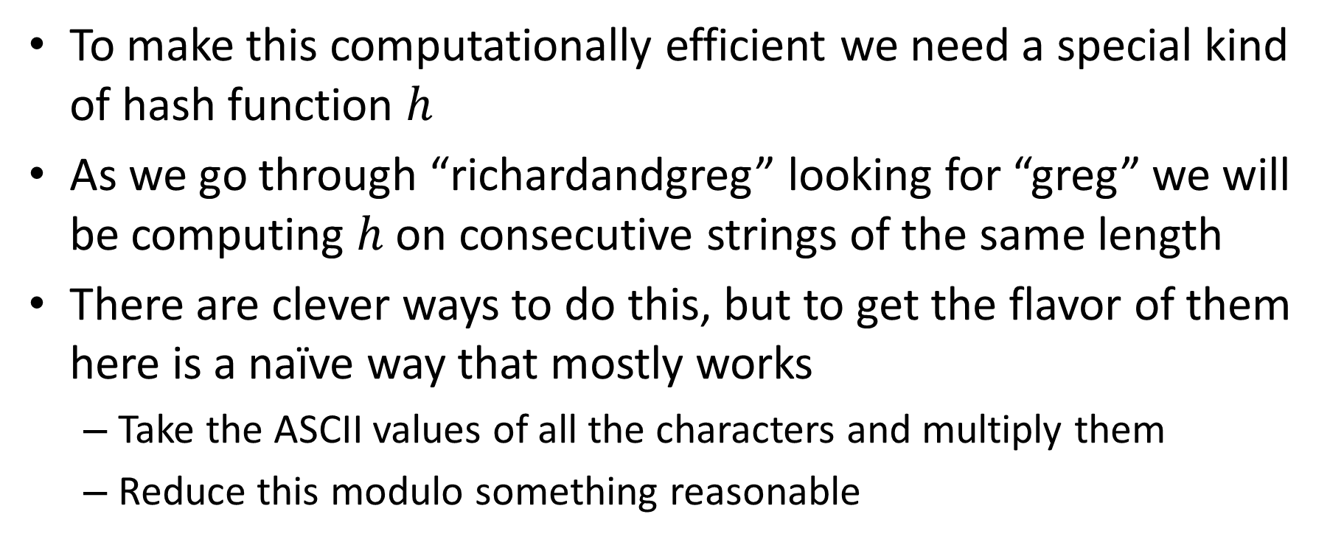
Rolling hash functions
To make this computationally efficient we need a special kind of hash function $h$
As we go through “richardandgreg” looking for “greg” we will be computing $h$ on consecutive strings of the same length
There are clever ways to do this, but to get the flavor of them here is a naïve way that mostly works
Take the ASCII values of all the characters and multiply them
Reduce this modulo something reasonable

Slide 20
Distributed hash tables (DHT)
BitTorrent, etc.
Given a file name and its data, store/retrieve it in a network
Compute the hash of the file name
This maps to a particular server, which holds the file
Sounds good! Until the file you want is on a machine that is not responding…
But is this a real issue? Aren’t computers pretty reliable?

Slide 21
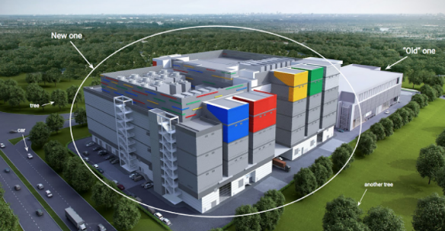
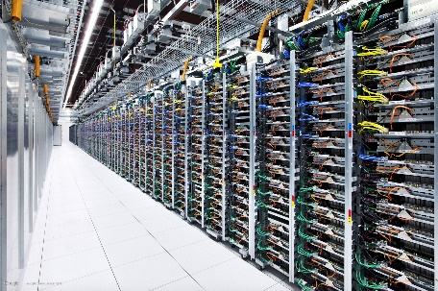
Google datacenter numbers (2008)
In each cluster's first year, it's typical that:
1,000 individual machine failures will occur;
thousands of hard drive failures will occur;
one power distribution unit will fail, bringing down 500 to 1,000 machines for about 6 hours;
20 racks will fail, each time causing 40 to 80 machines to vanish from the network;
5 racks will "go wonky," with half their network packets missing in action;
The cluster will have to be rewired once, affecting 5 percent of the machines at any given moment over a 2-day span.
About a 50 percent chance that the cluster will overheat, taking down most of the servers in less than 5 minutes and taking 1 to 2 days to recover.
Jeff Dean, “Google spotlights data center inner workings”, CNET May 2008

Slide 22
From filename to processor
Typically the result of a hash function is a large number
SHA-1 produces 160 bits (not secure!)
Map into servers with modular arithmetic
Reminder: 4 + 7 = 1 (mod 10)
Mod with powers of 2 is just the low-order bits
How do we handle a server crashing or rejoining??

Slide 23
Consistent hashing
Effectively the hash table itself is resized
Note that this is an important operation in general!
With naïve hash functions, resizing is a disaster
Everything needs to be shuffled between buckets/servers
Key idea is to give add state
Traditional hash functions are stateless/functional

Slide 24
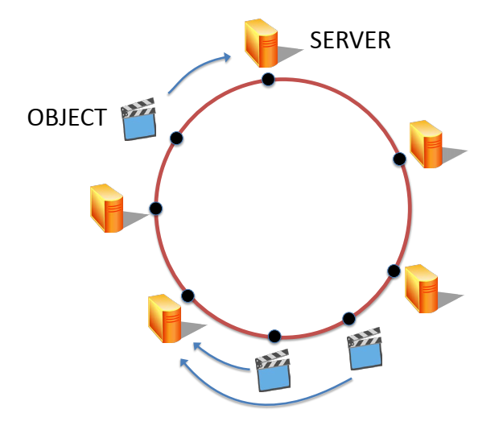
Hashing into the circle
Let’s convert the output of our hash function into a circle
For example, using the low-order 8 bits of SHA-1
We map both servers and data onto the circle
For a server, hash of IP address or something similar
Data is stored in the “next” server on the circle
By convention we will move clockwise
Figure from Maggs, Bruce M.; Sitaraman, Ramesh K. (July 2015), "Algorithmic nuggets in content delivery" (PDF), SIGCOMM Computer Communication Review, New York, NY, USA,45 (3): 52–66

Slide 25
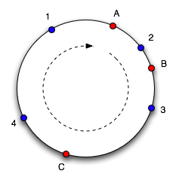
Example of consistent hashing
Data 1,2,3,4 stored on computers A,B
Servers->data (good quiz/exam question):
A->1,4
B->2
C->3
If C crashes, we just move 3 to A
Diagram taken from Tom White based on original article

Slide 26
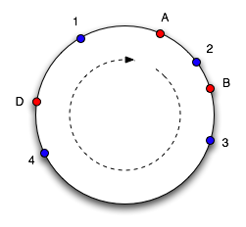
Gracefully adding/removing a server
Add server D after C crashes
Takes 3,4 from A
Servers->data:
A->1
B->2
D->3,4
This is a lot faster!
Naively, going from 3 to 4 servers moves 75% of data
With consistent hashing we move 25% of data
Advantage gets even larger for more servers
Diagram taken from Tom White based on original article

Slide 27
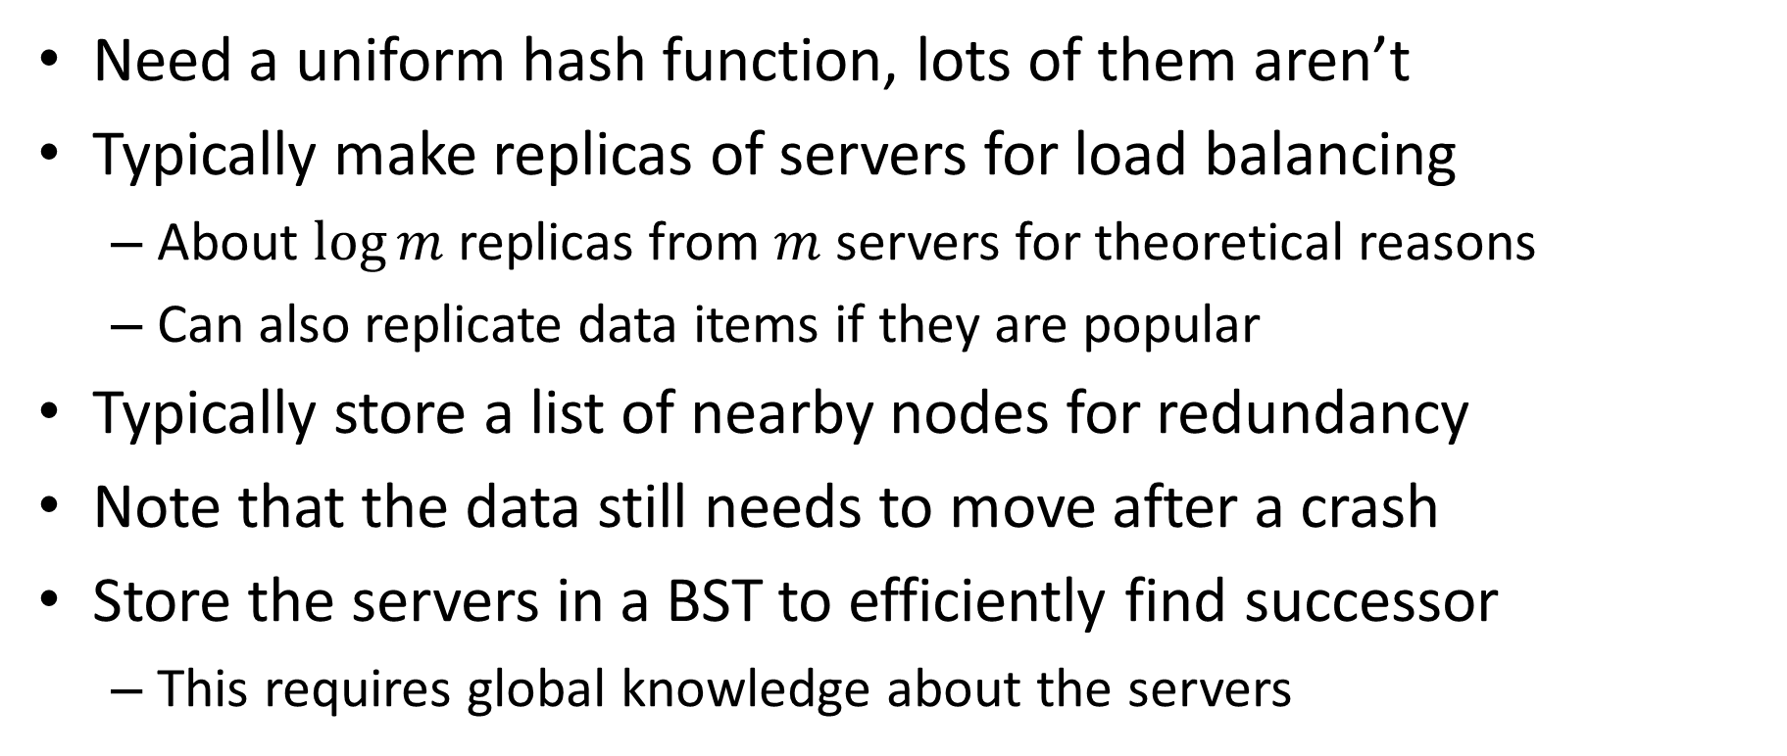
Improving consistent hashing
Need a uniform hash function, lots of them aren’t
Typically make replicas of servers for load balancing
About $\log{m}$ replicas from $m$servers for theoretical reasons
Can also replicate data items if they are popular
Typically store a list of nearby nodes for redundancy
Note that the data still needs to move after a crash
Store the servers in a BST to efficiently find successor
This requires global knowledge about the servers

Slide 28
Handling popular objects
Each object can have its own hash function
Basically, it’s view of the unit circle
Ensures that you are very unlikely to have 2 popular objects share the same server

